Slide 1
Building Your Resume & Personal Statement
STUDENT ACADEMY OF AUDIOLOGY
UNDERGRADUATE COMMITTEE

Slide 2
RESUME
Notes:
https://saa.audiology.org/educational-opportunities/undergraduate-students/undergraduate-resources/applying-audiology-0

Slide 3
FORMATTING YOUR RESUME
1-2 full pages MAX
Do NOT have one and a half pages.
One inch margins
Font size should be at least 11 and no larger than 12
Choose an easy to read font styles, such as Times New Roman, Arial, Calibri, Tahoma, etc
Use space wisely
Do not try to jam too much information on one page
Include 2-3 descriptions for relevant experience in a single line bullet
Use present tense verbs for current jobs and past tense verbs for past jobs
Print out a copy to see how the headings and sections line up. The format may look different on paper

Slide 4
RESUME CATEGORIES:
Name and Contact information (put in the header of every page)
Education
Relevant (Clinical) Experience
Work experience
Volunteer/Leadership Experience
Honors and Activities
Research / Presentation Experience (if applicable)
Skills (if applicable)

Slide 5
EDUCATION
University of Cincinnati
Bachelor of Arts, Communication Sciences and Disorders (City and State)
Anticipated Graduation, May 2020
Only include GPA if it will impress the application board; above a 3.5 is a good rule of thumb
Include Study Abroad program if applicable.

Slide 6
RELEVANT / CLINICAL EXPERIENCE
Clinical Experiences
Observation
Practical experience
Work / Internship that relates to Communication Sciences and Disorders
Work with CSD Department
Work at Children’s Hospital
Internship with non-profit organization
Describe with 2-3 lines your position
Use power adjectives and verbs
Ex: led, advocated, developed, volunteered, managed, dedicated, attentive, driven, devoted, etc.

Slide 7
WORK EXPERIENCE
You may include recent jobs that you have or have had that may contribute to your professional skills or those that demonstrate an ability to perform well as a student while also working
Nanny- Shows ability to work with young children
Manager of a retail store- demonstrates leadership skills
Describe with 2-3 lines your position
Job Title
Employer
Time Span

Slide 8
VOLUNTEER & LEADERSHIP EXPERIENCE
NSSLHA (include time span you were in organization)
Leadership position
Describe any community involvement you participated in within this organization
“Attend monthly meetings”
Student Academy of Audiology
“Attend monthly meetings within university chapter”
Parent Panel
Add any community service both professional and non professional
Sorority
Ronald McDonald House
Include brief description if not self explanatory
People like to see more time at one or two places versus a few hours at a lot of places. This demonstrates commitment.

Slide 9
HONORS & ACTIVITIES
Honors
These set you apart and you should be proud
Do not go into great detail as this takes up space
Award Name (Year you received award)
Magna Cum Laude / Cum Laude
Activities include Student Memberships
NSSLHA
August 2015 – Present
Sorority

Slide 10
PRESENTATIONS & RESEARCH
SKILLS
Capstone title (Name of school or institution research was conducted at), Capstone Advisor
List any presentations such as PRaISE
List any publications
Use proper citation format
Basic / Proficient / Fluent in an additional language besides English
Do not add “Proficient in Microsoft Word, Excel, Powerpoint”
Should be expected!

Slide 11
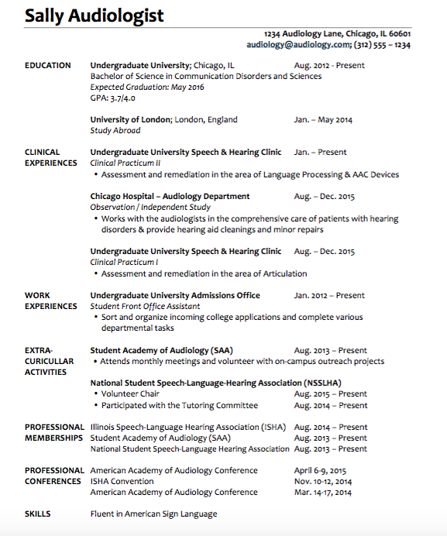
EXAMPLE

Slide 12
What Employers are looking for:
Ability to work in a team
Ability to verbally communicate inside and outside of the organization
Ability to make decisions and solve problems
Ability to obtain and process information
Ability to plan, organize, and prioritize work
Ability to communicate well / provide good service to patients
Keep these in mind!

Slide 13
PERSONAL STATEMENT
Notes:
https://saa.audiology.org/educational-opportunities/undergraduate-students/undergraduate-resources/personal-statement-supplement

Slide 14
What is a Personal Statement?
Allows you to reflect in your own words how you have gotten to this point in your education and what your future goals are
1 - 2 page document
What it should include:
Info on who you are
Your clinical skills and interests
Why you are interested in audiology or speech language pathology
Why you are interested in that graduate program
Research the program so you can add specifics to your personal statement
DO NOT rewrite your resume
It’s fine to touch on experiences that have shaped you but your reader should learn something new and take something different away from your resume and personal statement

Slide 15
Components of a Good Personal Statement
Tell a story
Think in terms of showing or demonstrating through concrete experience
Think of an interesting angle or “hook” that will draw the reader’s attention
If your statement is fresh, lively, and memorable, you'll be putting yourself ahead of the pack.
Be specific
Don't state that you would make an excellent audiologist or speech therapist unless you can back it up with specific reasons and experiences
Use the language professionals use in conveying your information
Concentrate on your opening paragraph
The lead or opening paragraph is generally the most important.
It is here that you grab the reader's attention or lose it.
It becomes the framework for the rest of the statement.

Slide 16
DO
DON’T
Typical margins
Easy to read font
Consistent formatting
Keep the same tense throughout
Be as specific as possible
“My skills/experience make me an ideal candidate because…..”
Be confident
Save it with a file name that includes your name
Save and send as a PDF
Go below a 12 point font
Reference high school activities
“My skills/experience make me an ideal candidate.”
Use “I think”, “I feel”, “I believe”
This comes off as insecurity
Be generic or use cliches
Use vocabulary you wouldn’t use in a normal conversation
Rephrase or reiterate your resume
Send as a word document

Slide 17
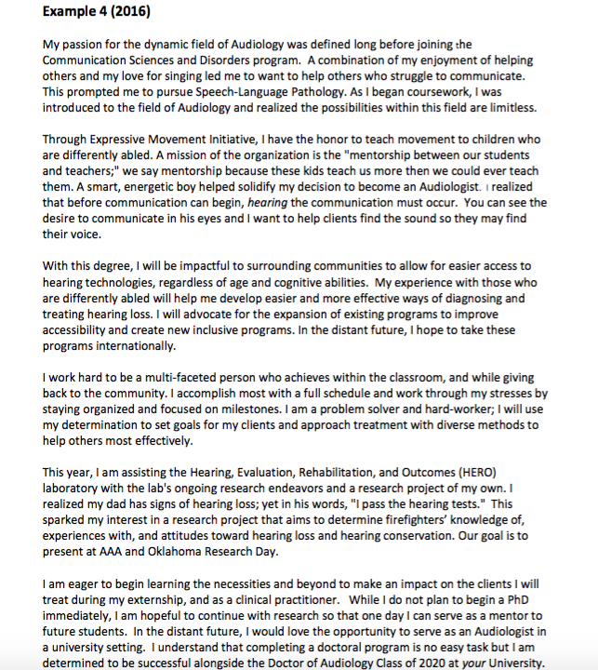
EXAMPLE

Slide 18
PROOF READ
Proof read, proof read, proof read
Have a friend proof read
Have a parent proof read
Have a partner/spouse proof read
It’s ok to have multiple rough drafts!

Slide 19
SAA RESUME REVIEW /PERSONAL STATEMENT SERVICE
Undergraduate associate members of SAA have the opportunity to submit their personal statement to the Resume Review service provided by the American Academy of Audiology.
Have your resume reviewed by audiologists and receive feedback about how to tailor your resume to the field of audiology and audiology graduate programs.
If interested, complete the Resume Review Request Form and submitting all materials to resumereview@audiology.org.
All SAA Undergraduate resources can be found (with or withour membership) at https://saa.audiology.org/educational-opportunities/undergraduate-students/undergraduate-resources/

Slide 20
QUESTIONS?
Paige Wulliger
Undergraduate Liaison
wulligpm@mail.uc.edu

