Slide 1
NSSLHA-MC2 Meeting
November 12th, 2020

Slide 2
Aubrey Stoll
UC Racial Awareness Program (RAPP)

Slide 3
UC’s Racial Awareness Program (RAPP)
9 month program of UC students, staff, and peer leaders that work to fight oppression through individual awareness and collective action.
A place to not only learn about other perspectives but to learn and explore your own identity
Empowered to make a difference even if you feel / or have felt powerless
Through full participation in RAPP, you will:
Develop relationships with 35+ other Bearcats
Enhance individuals abilities to communicate across different social and cultural backgrounds and beliefs
Deepen their understanding of oppression
Develop knowledge and skills to more effectively fight oppression and create inclusive communities

Slide 4
RAPP is a 9-Month commitment!
Meetings Every other Thursday from 6-8:30 PM
The RAPP Welcome
Two RAPP Retreats (one fall, one spring)
10 RAPP Sessions
Champions of Social Change Banquet
RAPP is a “one-time deal”
RAPP groups bond early and strongly
RAPP is a structured, accumulative program
RAPP is limited to 35 members per year

Slide 5
Contact Info!!
Website: https://www.uc.edu/campus-life/sald/social-change-and-leadership/RAPP.html
Feel free to email me with any questions at Stollaw@mail.uc.edu!
Notes:
https://www.facebook.com/RAPP.UC/
https://instagram.com/cincirapp?igshid=1jedv6iemrdoo
https://www.uc.edu/campus-life/sald/social-change-and-leadership/RAPP.html

Slide 6
Dr. Katherine Russell, AuD, CCC-A

Slide 7
Taryn Booker
MC2

Slide 8
What is DEI?
Diversity: Includes but is not limited not race, gender, socioeconomic status, religion, sexuality
Equity: Fair treatment, opportunity advancement for all while striving to identify and eliminate barriers that have prevented the full participation of some groups
Inclusion: Authentically bringing traditionally excluded individuals and/or groups into processes, activities, and decision/policy making in a way that shares power and ensures equal access to opportunities and resources
Notes:
Equity: The guarantee of fair treatment, access, opportunity, and advancement for all while striving to identify and eliminate barriers that have prevented the full participation of some groups
Inclusion: Authentically bringing traditionally excluded individuals and/or groups into processes, activities, and decision/policy making in a way that shares power and ensures equal access to opportunities and resources.
https://www.d5coalition.org/tools/dei/

Slide 9
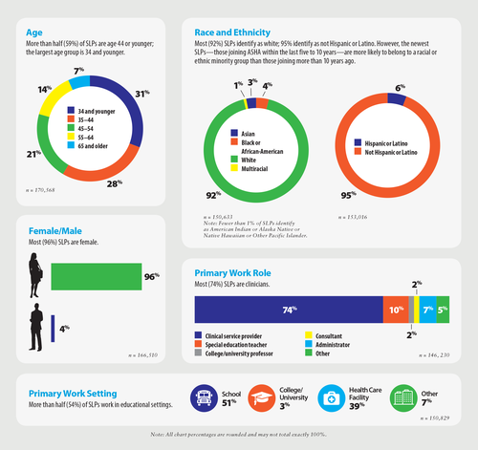
Demographics of SLPs as of 2919

Slide 10
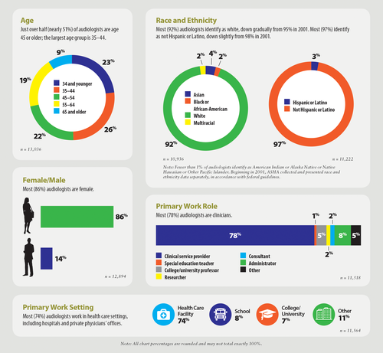
Demographics of Audiologist in 2019

Slide 11
What are some potential barriers?
Lack of Knowledge about the fields/outreach
Hositility/Imtimidation
Financial Burden
Application Process

Slide 12
Inclusivity
Diversity is not inherently Inclusive
Accommodations
Code of Conduct
CROWN Act of 2020
AAE or AAVE
Is it perceived to be professional in your workplace, do you personally find it professional or unprofessional?
Diversity without Inclusivity can lead to Tokenism
Notes:
Crown Act: Creating a Respectful and Open World for Natural Hair Act of 2020 or the CROWN Act of 2020
This bill prohibits discrimination based on a person's hair texture or hairstyle if that style or texture is commonly associated with a particular race or national origin. Specifically, the bill prohibits this type of discrimination against those participating in federally assisted programs, housing programs, public accommodations, and employment.
Persons shall not be deprived of equal rights under the law and shall not be subjected to prohibited practices based on their hair texture or style.

Slide 13
What are the benefits?
Representation Matters
Likely to work with underserved/underrepresented communities
Generally speaking diverse workforces provide better care.
Implicit Bias
Language Barriers
Cultural Difference
Historically
Notes:
https://gbpi.org/unlocking-benefits-diverse-health-workforce/#:~:text=A%20diverse%20health%20care%20workforce,health%20care%20for%20vulnerable%20people.

Slide 14
Cultural Competency
Define culture broadly.
Value clients' cultural beliefs.
Recognize complexity in language interpretation.
Facilitate learning between providers and communities.
Involve the community in defining and addressing service needs.
Professionalize staff hiring and training.
Institutionalize cultural competence.

Slide 15
What’s Next
What can I do now?
What am I going to do in years to come?
How can I make those who are different from me feel welcome, seen, and heard?
How am I going to hold myself and others accountable?
This is a learning process!

Slide 16
NSSLHA
Announcements

Slide 17
“Know Before You Go” Pre-Break COVID Testing
Free COVID-19 testing
Nov. 16-18
Results available within 1-2 days after test
Sign-up now!
https://wildhealthcovid19testing.as.me/UCmaincampus

Slide 18
NSSLHA Fall 2020 Evaluation
As a student organization, we highly value your input! Please fill out this short survey regarding NSSLHA meetings/events this semester.
This survey will be anonymous. After you take the survey, send a screenshot of the “Your response has been recorded” to nsslha.uc@gmail.com or urbaneh@mail.uc.edu to earn 0.5 NSSLHA Points!
https://forms.gle/2oddNCoMvfikkRCH8

Slide 19
Autism Society of Greater Cincinnati
During these sessions NSSLHA members would take notes and assist the person running the game, as well as have fun and participate of course!
I am looking for 2 NSSLHA members per session and ideally there would be 8 members for each event and would rotate every week. IDEALLY, this means you would only go to 1 event a month, so grab a friend a sign up! If not that many people sign up you may need to run 2+ events per month!
These events will last through the school year so it is important to make connections with those you are on call with!
https://docs.google.com/spreadsheets/d/1lXcit0A0bLE8tZZuvErY4F9NM2CRd7l63bDwUG_eqzQ/edit?usp=sharing
The Autism Society of Greater Cincinnati is an amazing organization that provides resources, support, and activities for families all along the spectrum.
The Autism Society of Greater Cincinnati hosts Friday Teen Time Hangouts from 5:30-7 and Friday Game Nights with Adults from 7:30-9 for their members that occur every week and asked us to participate.
Questions, contact Olivia Stark: starkog@mail.uc.edu (513)889-8125

Slide 20
Marjorie Book - Poetry Event
This organization brings teenagers and adults with and without disabilities together for continuing education classes, service learning projects and theatrical productions. They believe that teenagers and adults of various abilities can benefit from coming together for activities of common interest and sharing their gifts and strengths.
This event is THIS Saturday from 7-8pm over Webex!
If interested email linkjc@ucmail.uc.edu for access! There will be a NSSLHA executive member there to take your attendance.
This event can go towards service hours for a scholarship if needed!
Worth 1 NSSLHA point
Questions, contact Olivia Stark: starkog@mail.uc.edu (513)889-8125

Slide 21
Ronald McDonald House
https://www.rmhcincinnati.org/get-involved/donate-items/wish-list/
Here are your options for donations:
Pick up the items from your local store or Amazon and drop them off at my apartment, 220 Donahue Street, and I’ll have a dropbox on my porch.
Get the items and drop them off on your own at the Ronald McDonald House and send me a picture of the items or send me a picture of your receipt.
Order items to send directly to the Ronald McDonald House from Amazon and send me a screenshot of your order.
If I have access to HSB in December I will arrange a day for you to drop off the items to me as well!
Between now and the next meeting we will be participating in Ronald McDonald House’s Help From Home Wish List! Final day to donate is Thursday, Dec 3rd!
They depend on donated food and supplies to keep their House stocked with all the basic necessities a home requires.
Their Amazon wish list is always up-to-date with their most needed items.
KEEP IN MIND: Due to the immune-compromised situation of our guest children, they are only able to take new and unopened items.
Questions, contact Olivia Stark: starkog@mail.uc.edu (513)889-8125

Slide 22
NOVEMBER SOCIALS
PAC Trivia Night: November 19th, 8 pm
Virtual Game Night: Monday November 30th, 7 pm
Microsoft Teams
Clue, Uno, Quiplash/ Jackbox.tv
Survey Monkey

Slide 23
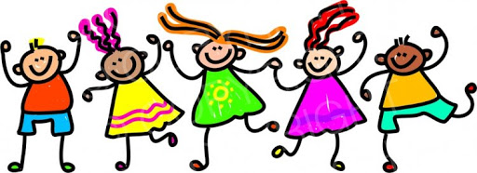
NSSLHA Families
Reminder to seniors to get events in before end of the semester!
2 external events & 2 nsslha meetings
1 each semester ideally
Remember to send screenshots as proof to carneysm@mail.uc.edu

Slide 24
Fundraiser Outcome!!
We raised.....$568.00
Thank you to everyone who participated, you’re awesome!
NSSLHA points have been recorded for everyone who emailed me, shoot me an email after the meeting if you haven't already.
Winter Fundraiser announcements are coming soon! :)
Thank you!!
Questions, suggestions, and feedback welcome. My email is brocklc@mail.uc.edu

Slide 25
Important Dates
December NSSLHA Meeting:
Thursday, December 3rd at 6:30PM
Wear your pajamas! Drink hot cocoa!

Slide 26
MC2
Announcements

Slide 27
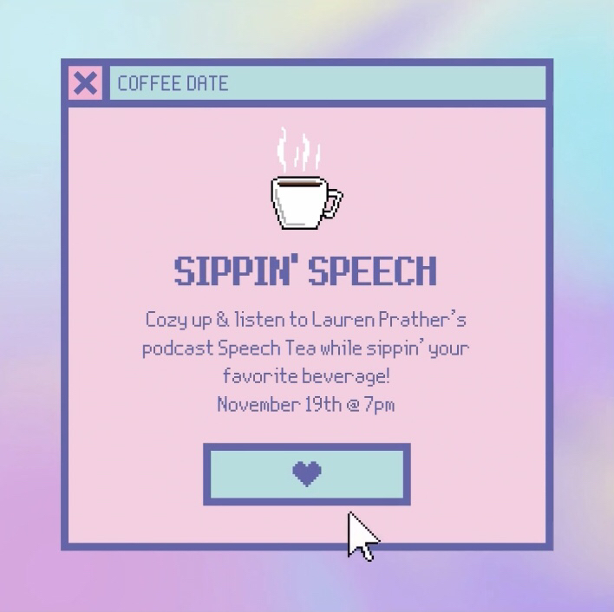
Upcoming November Social
Grab a hot drink with us on November 19th to learn more about misconceptions in adult therapy from our recent guest speaker Lauren Prather in her podcast @7PM!

Slide 28
Student Academy of Audiology

Slide 29
One-on-One Resume/Personal Statement Review
Break-out Rooms
RSVP List:
Bri Ferdinando
Hailey Spencer
Justine Heider
Lyndsey Glaser
Aubrey Stoll
Megan Miller
Molly Luegering
Sarah Rinehart
Drop-ins are available!

Slide 30
One-on-One Resume/Personal Statement Review
Break-out Rooms
Drop-ins are available!
Send your email in the chat to get added to the breakout rooms for a drop-in review

Slide 31
If you did not sign-up for the SAA one-on-one review sessions OR you are not interested in a drop-in review, you are free log off of Teams!
Thanks for attending the November NSSLHA-MC2 meeting

Slide 32
One-on-One Resume/Personal Statement Review
Break-out Rooms
Instructions for joining break-out rooms was emailed to you. The link is included in the Excel file attached to the email
You can also access it through the sub-channel on the NSSLHA Team that you were added to. Each sub-channel is assigned one NSSLHA/MC2 member and one SAA member. Once you get to the sub-channel, select “Start meeting” or “Join meeting”

Slide 33
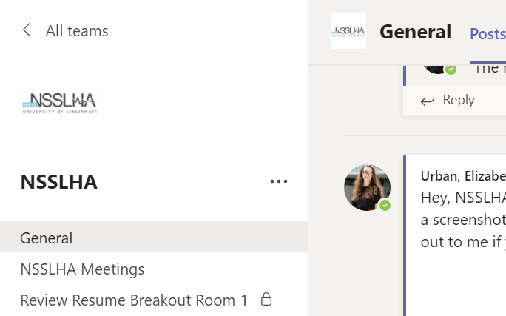

Slide 34
Break-out rooms are in session!
Once you are finished meeting in your break-out room, you are free to log off of Teams! If you have any questions or technical difficulties, I will stay on the main meeting to answer questions

