Slide 1
NSSLHA January Meeting
January 21, 2021

Slide 2
Margie Kessel, MS, CCC-SLP

Slide 3
Courtney Hausfeld, MS, CCC-SLP

Slide 4
NSSLHA
Announcements

Slide 5
Spring Organization Fair
Thank you to everyone who came to visit NSSLHA today!
Still have questions? Feel free to email nsslha.uc@gmail.com or urbaneh@mail.uc.edu

Slide 6
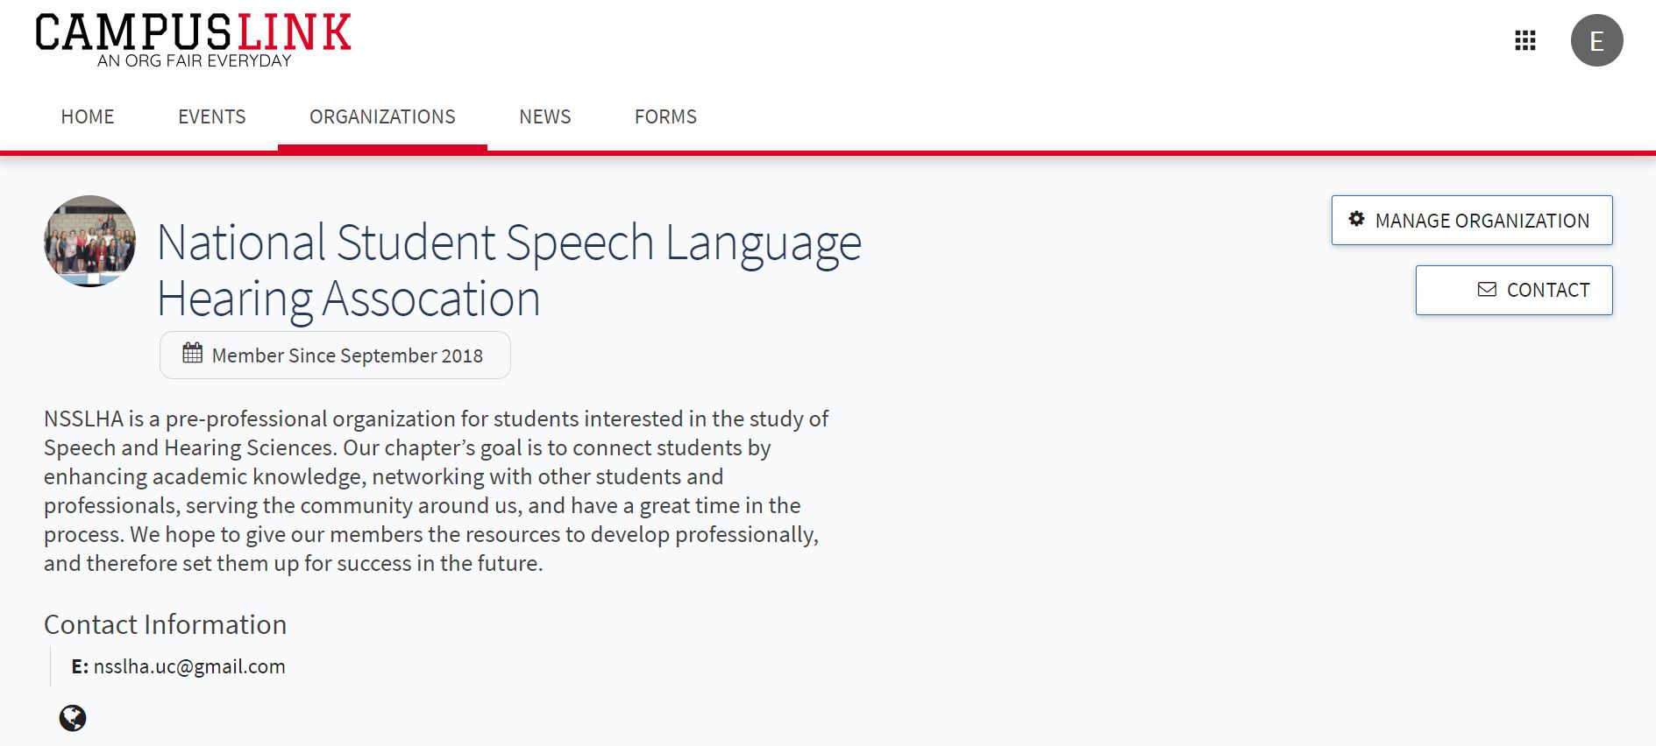
Sign-Up for NSSLHA on CampusLink
The link will be emailed to you tomorrow!

Slide 7
Public Relations
Socials:
Coffee Chat: January 28th at 6 p.m.
Game Night: February 4th at 6 p.m.
Friday Highlights/ New things to showcase on our social media pages!

Slide 8
NSSLHA Social Media
@UC_NSSLHA
@UC_NSSLHA
@UCNSSLHA

Slide 9
Community Service: Literacy Network of Greater Cincinnati
What you can/cannot donate:
Their critical need is new and gently used elementary aged books, Pre-K through 6th grade reading level, as well as books that include diverse characters and experiences.
They cannot accept adult books, magazines, textbooks, encyclopedias, coloring books or highly damaged books.
People who wish to donate money, instead of a book, can do so online at https://www.LNGC.org/donate or by mail to 635 W 7th St., Suite 309, Cincinnati, OH 45203
How to drop it off:
There will be a dropbox on my front porch, 220 Donahue Street, in Clifton. I am also more than happy to have books sent to me via mail/amazon that I can drop off. I am also able to pick up a book from you if you live in Clifton and have no way to get to me.
I am accepting donations until February 7th!
I really want this to go well, so please raid your parents houses for books from your childhood or ask friends and family if they have any books they are willing to donate!
The topic of literacy pertains to our major, so it is important for us to do our part and provide books to kiddos that need them!

Slide 10
Community Service Opportunity : Marjorie Book
Virtual Open Mic Poetry Readings (Saturday, January 23 from 7:00 - 8:00 PM)
Please join to listen to poetry, and maybe read some poetry you have read or that you have written. They do own a large selection of American and world poetry and so please let us know if you would like to borrow one of their books in advance.
Virtual Tabletop Role-Playing: Star Finder (Saturday, January 30 from 7:00 - 8:30 PM)
Their group of 6-12 participants plays Star Finder on a monthly basis. Starfinder is an interactive role playing game similar to Dungeons and Dragons (https://paizo.com/starfinder). They always welcome new players. No previous experience is required, but bring your imagination as we breathe life into fictional characters living in this futuristic, outer space-oriented world.
Registration:
To join their virtual events, please register in advance by contacting Joe Link at marjoriebook1993@gmail.com or 513-328-6300. They accept registrations up to one hour before the virtual event begins. When you register, you will receive an invitation by email to join them through WebEx.
Please let them know if you need assistance with accessing an electronic device for their events; they may be able to help. If you have any questions, contact Joe Link at (513) 328-6300 or marjoriebook1993@gmail.com

Slide 11
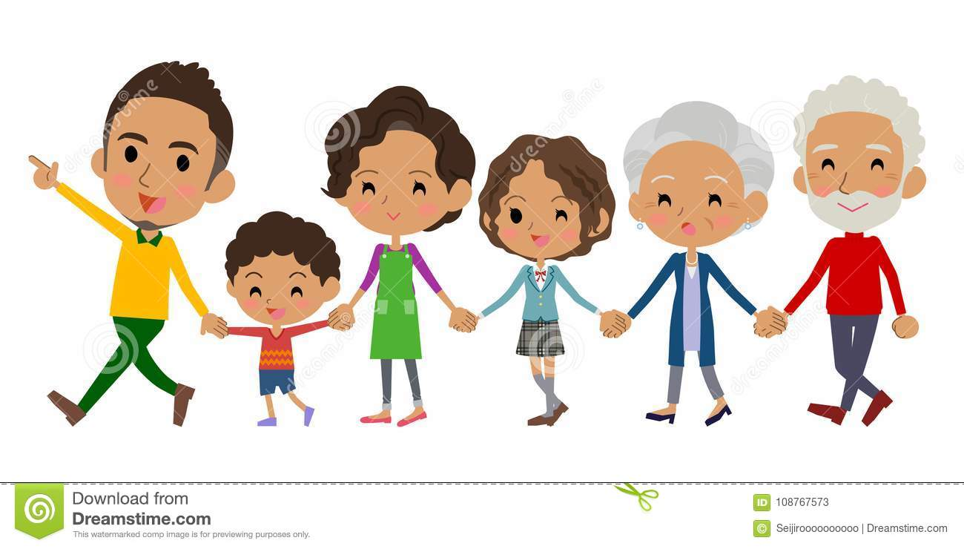
NSSLHA FAMILIES
REMINDER OF REQUIREMENTS
2 NSSLHA Meetings
2 External Events
Variety of options: coffee dates, nsslha social, virtual dinner
TBD Spring Project… more info to come
If occurs it will be a donation based project
Food, hygiene projects, clothes, household supplies, etc...

Slide 12
FUNDRAISING UPDATES
No beer stand at basketball games this season unfortunately
Hope for 2021 football season!
More information to come for our upcoming fundraiser, keep an eye out for an email!
As always, any questions or suggestions please feel free to email me
BrockLC@mail.uc.edu

Slide 13
Important Dates
Next meeting: Thursday, February 18th at 6:30 PM
Coffee Chat Social: January 28th at 6 p.m.
Game Night Social: February 4th at 6 p.m.
Volunteer Poetry Night: January 23th at 7:00 PM
Volunteer Tabletop Role-playing “Star Finder”: January 30th at 7:00 PM

