Slide 1
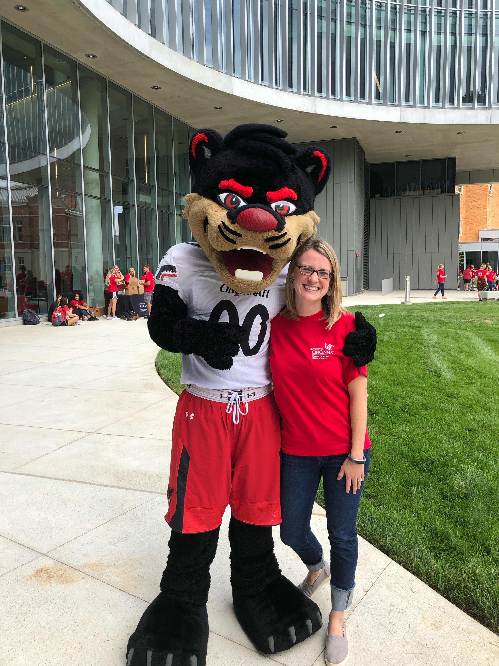
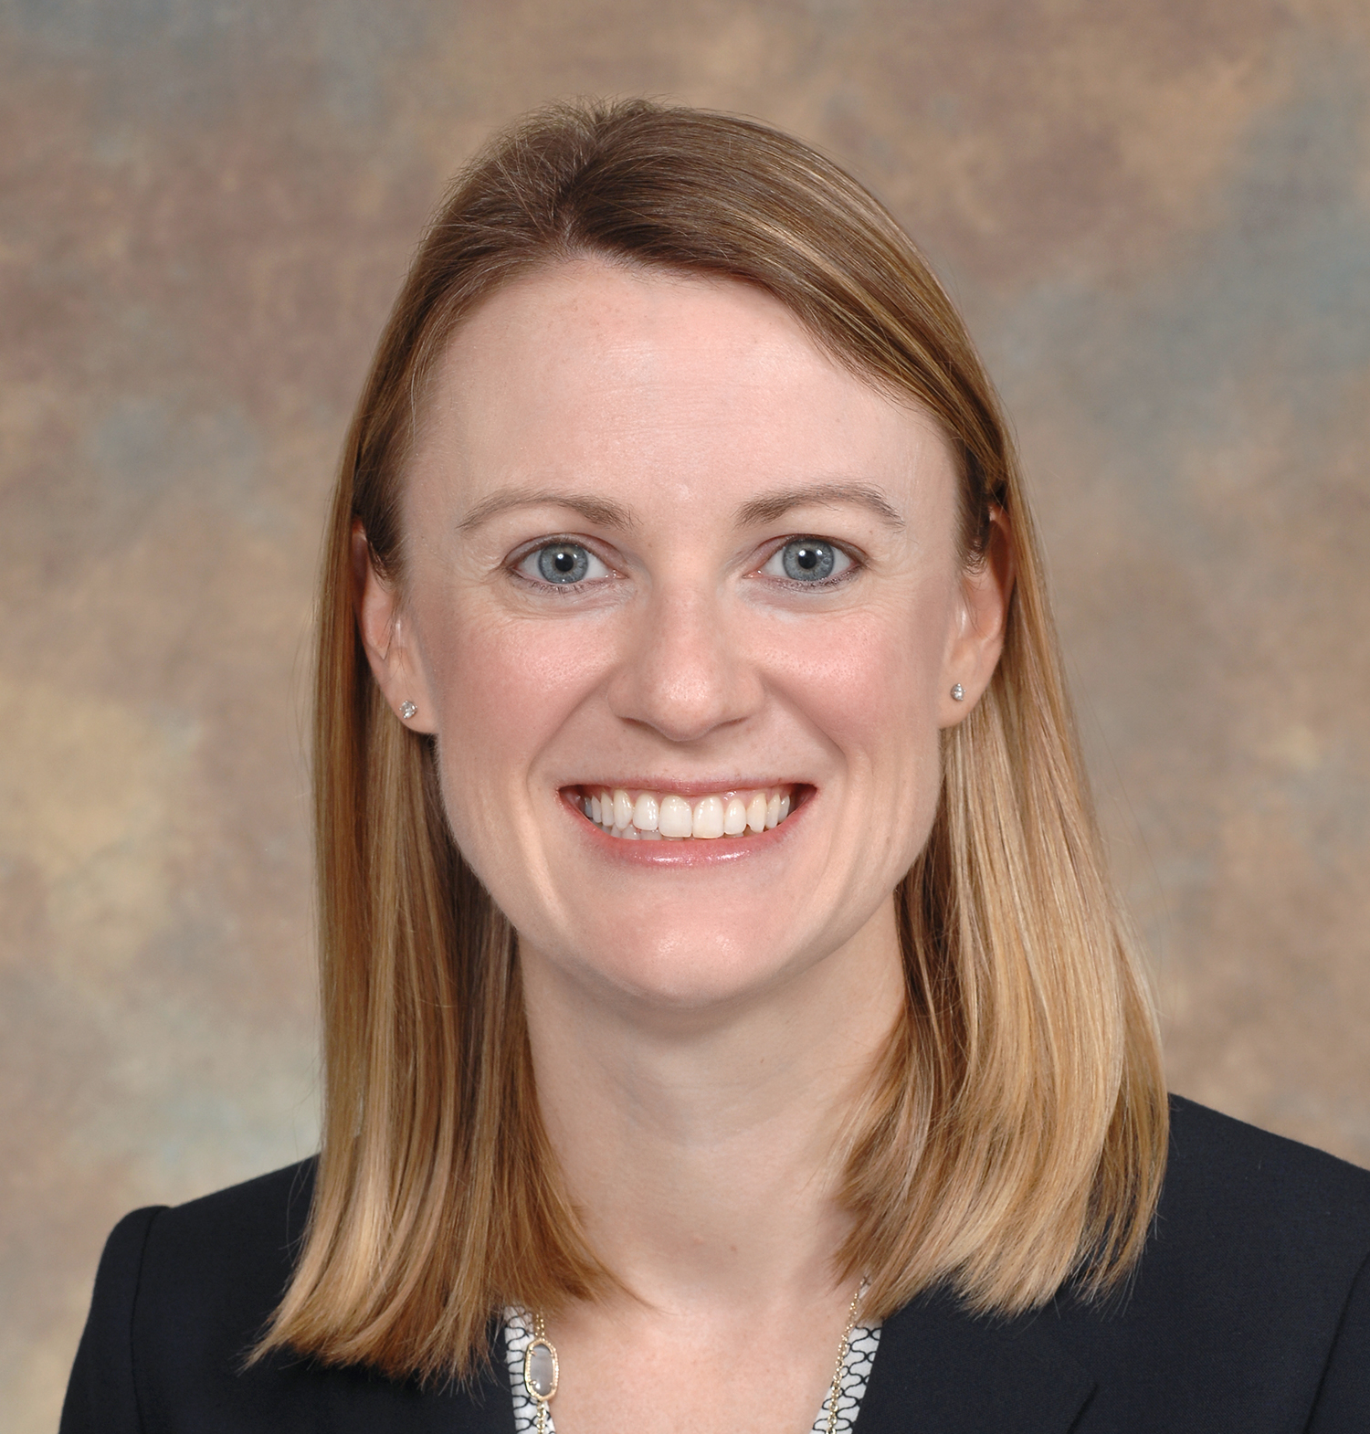
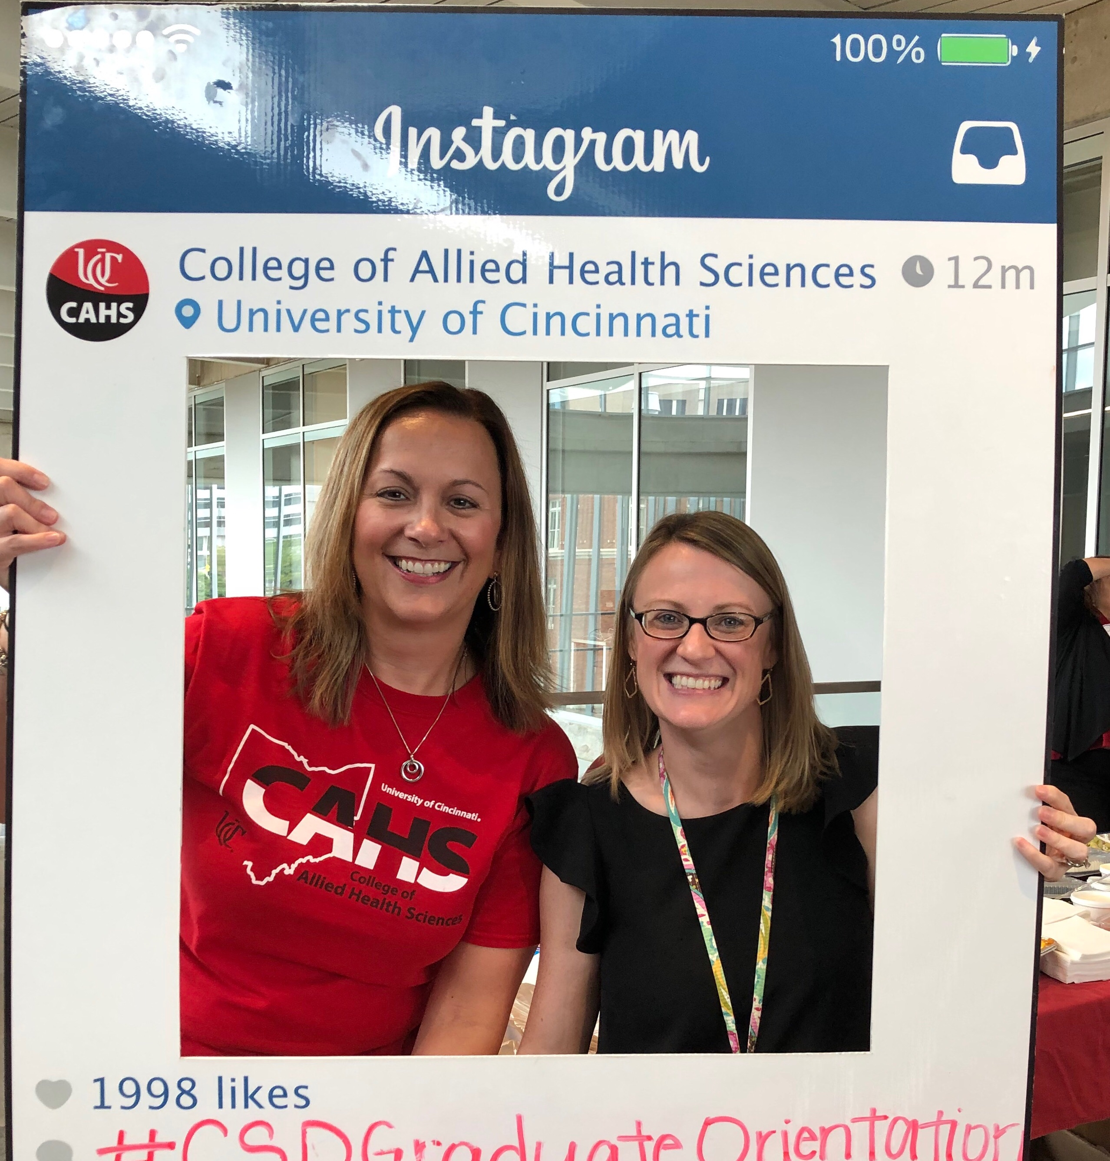
Dr. Katie Russell
Audiology Program Director

Slide 2
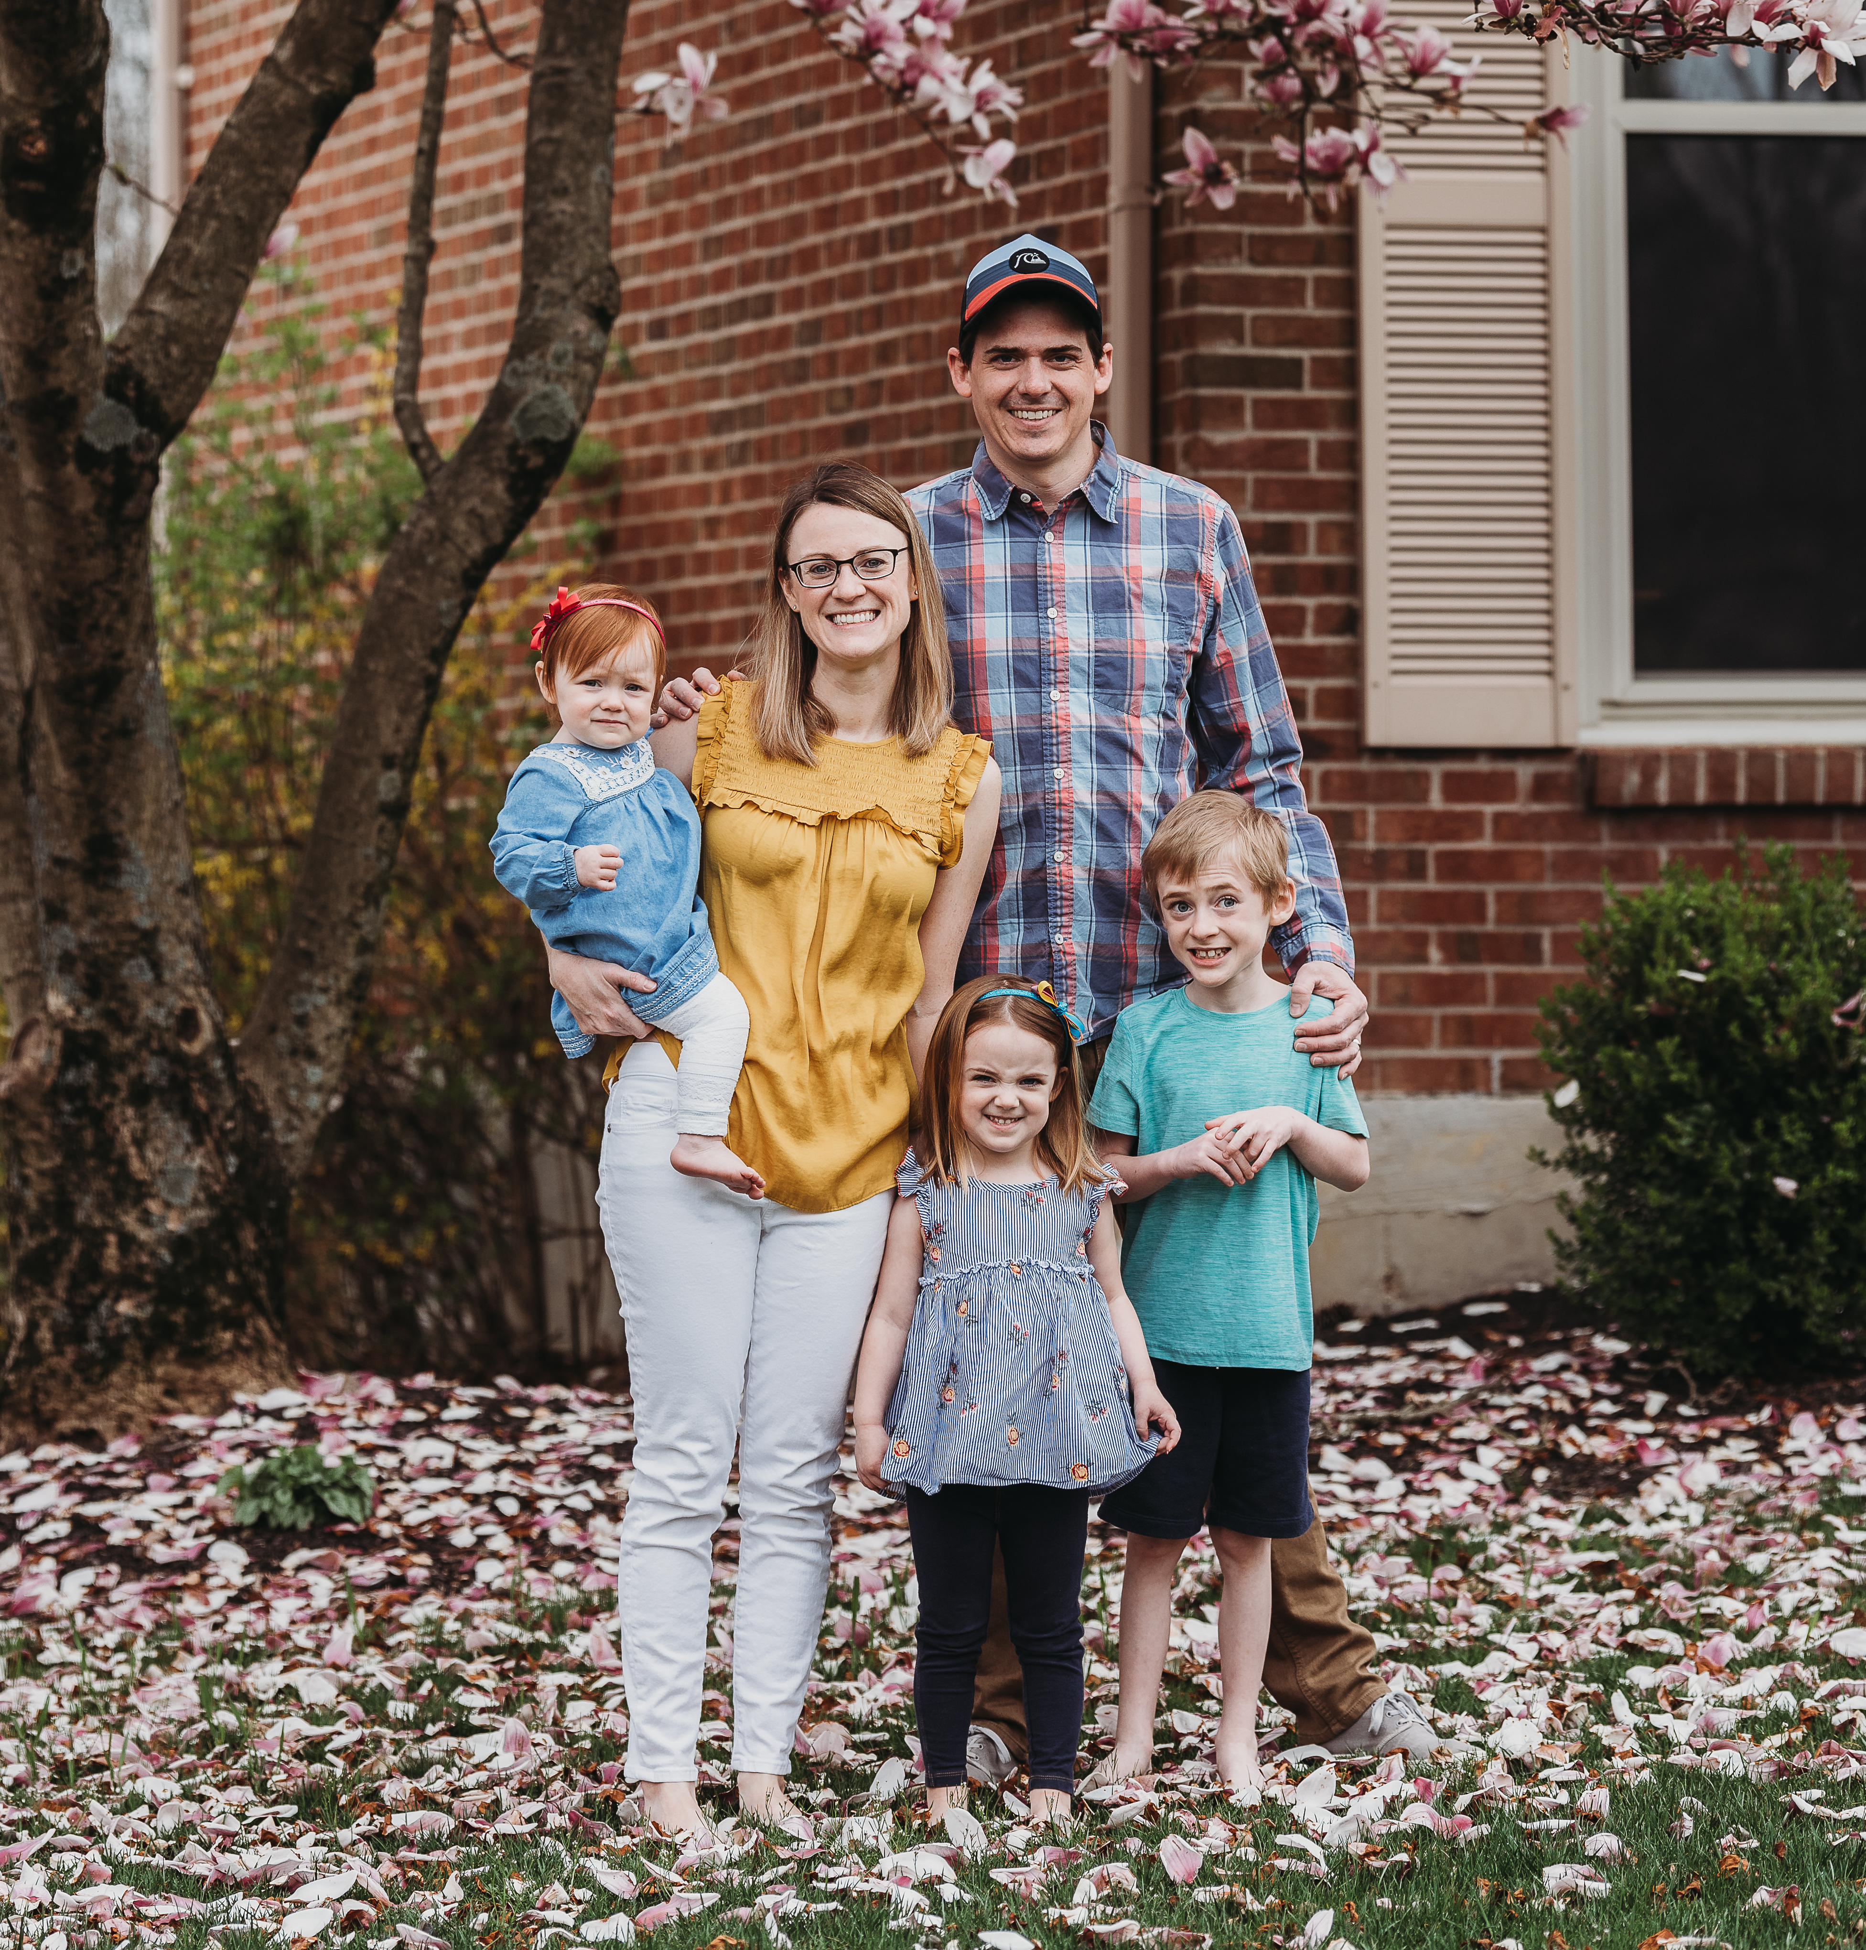
Audiologist, teacher, wife and mom
Who do you want to be?

Slide 3
Your Career Path
Life Experiences
Graduate Student
Undergrad. Student
High School Graduate
Notes:
Life experiences include professional and personal

Slide 4
Audiology Work Settings
Veteran Affairs Hospital
Private Practice
Pediatric Hospital
Adult Hospital
ENT Practice
Non-Profit Clinic
School
Public School
School for the Deaf
Listening and Spoken Language School
Industrial
Research

Slide 5
Audiology Specialty Areas
Geriatric
Pediatrics
Tinnitus Evaluation and Treatment
Vestibular Assessment and Rehabilitation
Implantable Hearing Devices
Cochlear Implants
Middle Ear Implants
Bone Anchored Hearing Aids
Traditional Amplification
Interoperative Monitoring

Slide 6
Disparities in Hearing Health
Across the Lifespan

Slide 7
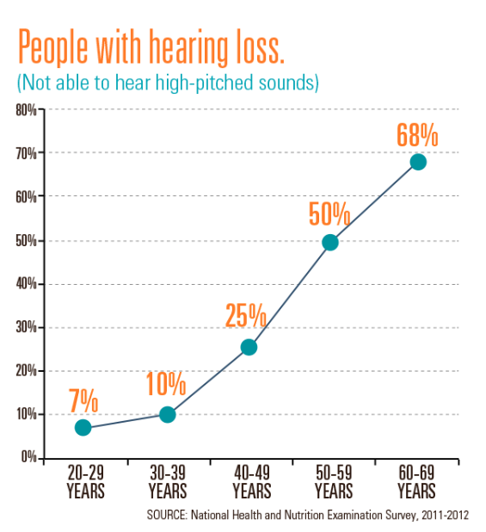
Statistics
Hearing loss is one of the top three common chronic conditions in the US
Hearing loss prevalence increases with age
One in eight people in the United States (13 percent, or 30 million) aged 12 years or older has hearing loss in both ears, based on standard hearing examinations
About 6,500 U.S. infants born in 2017 were identified early with a permanent hearing loss
An estimation of 14.9% of School-Aged Children in the US have hearing loss
Notes:
Graph showing how with the increase of age, the percent of people who are not able to hear high pitched sounds increases. https://www.cdc.gov/vitalsigns/hearingloss/infographic.html
Blackwell DL, Lucas JW, Clarke TC. Summary health statistics for US adults: National Health Interview Survey, 2012. Vital health statistics, series 10, no. 260. Atlanta, GA: National Center for Health Statistics, CDC; 2014.
Lin FR, Niparko JK, Ferrucci L. Hearing loss prevalence in the United States.(link is external) [Letter] Arch Intern Med. 2011 Nov 14; 171(20): 1851-1852.
CDC’s Third National Health and Nutrition Examination Survey (NHANES III), 1988 – 1994
Should Note that:
Non-Hispanic white adults are more likely than adults in other racial/ethnic groups to have hearing loss; non-Hispanic black adults have the lowest prevalence of hearing loss among adults aged 20-69.
Hoffman HJ, Dobie RA, Losonczy KG, Themann CL, Flamme GA. Declining Prevalence of Hearing Loss in US Adults Aged 20 to 69 Years(link is external). JAMA Otolaryngology – Head & Neck Surgery. December 2016 online.

Slide 8
Adults
Black and Hispanic adults are less likely to use hearing technology compared to white adults despite being more likely to have had a hearing assessment.
Evidence shows correlation between hearing loss and dementia
Black and Hispanic adults are at greater risk for developing dementia following a hearing loss.
Adults being seen for a cochlear implant evaluation are disproportionately white when compared to the geographic regions of CI Center sites and study sites
Gifford, R. Hearing Health Care for All, The Hearing Journal: July 2018 - Volume 71 - Issue 7 - p 6
Notes:
J Aging Health. 2016 Feb;28(1):68
Aging Ment Health. 2014;18:671; The Lancet. 2017; 390: 2673
J Am Geriatr Soc.017 Aug;65(8):1691
Ear Hear. 2014 May-Jun;35(3):289
Also think about noise induced hearing loss caused by work environment such as factory etc.

Slide 9
Children
Children born with a congenital hearing loss require early diagnosis and intervention (technology and habilitation) to develop listening and spoken language.
African American infants in an urban setting have a higher rate of loss to follow-up following a failed newborn hearing screen.
Children in rural and underserved areas often have their hearing loss diagnosed much later which is further increased for those of Hispanic and non-English speaking families.
Bush ML, Kaufman M, McNulty B. Disparities in Access to Pediatric Hearing Healthcare. Curr Opin Otolaryngol Head Neck Surg. 2017 October ; 25(5): 359–364.
Notes:
Bush ML, Bianchi K, Lester C, et al. Delays in diagnosis of congenital hearing loss in rural children. J Pediatr. 2014; 164(2):393–397.
Zeitlin W, Auerbach C, Mason SE, Spivak LG, Reiter B. Factors Related to Not Following Up with Recommended Testing in the Diagnosis of Newborn Hearing Loss. Health & Social Work. 2017; 42(1):24–31. A prospective quantitative longitudinal study tracking 203 families demonstrating that urban African American babies are at risk of being loss to follow up for newborn diagnostic hearing testing.

Slide 10
Deaf Community
6.9 times more likely to have inadequate health literacy when compared to normal hearing adults
Only an estimated 2% of Deaf adults in the US who need mental health or substance abuse support receive it
Access to health education limited in their primary language and face to face information provided through an interpreter and not direct to the patient
Healthcare workers lack knowledge on Deaf culture which can lead to misconceptions
Deaf adults who had a healthcare provider that signed were more likely to access preventative services when accounting for race, gender, income, health status, health insurance, and education.
Notes:
McKee, M. M., Paasche-Orlow, M. K., Winters, P. C., Fiscella, K., Zazove, P., Sen, A., & Pearson, T. (2015). Assessing health literacy in deaf American sign language users. Journal of Health Communication, 20(2), 92–100.
McKee MM, Barnett SL, Block RC, Pearson TA. Impact of communication on preventive services among deaf American Sign Language users. Am J Prev Med. 2011 Jul;41(1):75-9.
https://www.nasmhpd.org/sites/default/files/InformationGapsResearchPaper.pdf

Slide 11
Being Mindful of Cultural and Linguistic Diversity in Everyday Practice Audiology Today July/August 2020 Authors: Katie M Colella, Laura Gaeta, Erica Friedland, Mary A. Hudson, and Debra Busacco
Follow best-practice for using interpreters
Avoid idioms, metaphors, colloquialism, or jargon. Phrases used by native English speakers such as “feeling blue” or “let’s wrap up” may not translate effectively into another language.
Review any professional vocabulary that could require an expanded explanation with the interpreter.
Allow the interpreter enough time to interpret all messages.
Look at and speak with the patient or caregiver(s), not the interpreter or phone.
Ask the interpreter, patient, or caregiver(s) if he or she has any questions or needs clarifications.
Defer from using a family member as an interpreter unless it is truly the only option.
Avoid microaggressions
Notes:
A culturally and linguistically diverse (CLD) patient is one who comes from a home environment where a language other than English is spoken and whose cultural values differ from mainstream culture.
Microaggressions are brief statements or behaviors that, intentionally or not, communicate a negative message about a non-dominant group, including the CLD population

Slide 12
Be mindful of health literacy and guide patients to ask the right questions.
Recommendations for improving health literacy (AMA, 2007):
State the most important information first and explain why that information is important.
Confirm patient understanding by asking for a summary.
Supplement conversations with written materials that focus on key information and include visuals, while keeping in mind that translated materials do not always increase health literacy.
Avoid technical terminology and language.
Speak in simple sentences and use active voice.
Provide captions for all graphics, including step-by-step illustration guides.
Use high-contrast paper and font color. Font size should also be large.

