Slide 1
NSSLHA Meeting
December 4th 2014

Slide 2
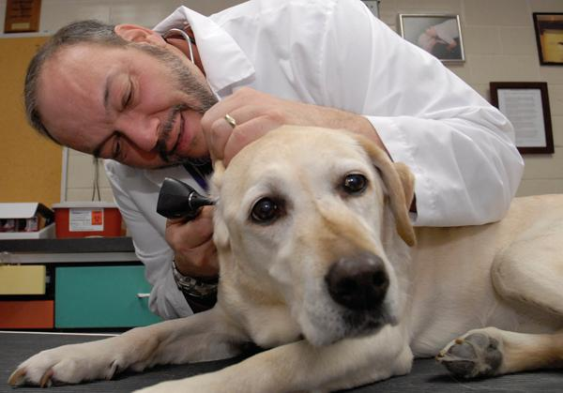
Dr. Pete Scheifele
UC Professor, Director of FETCH Lab, retired Naval Diver

Slide 3
Just for fun clip
In case you need a laugh during finals week:)
https://www.youtube.com/watch?v=6VFOeVxNO2s

Slide 4
Community Service

Slide 5
Looking towards the Spring
Ronald McDonald House
7pm Snack
Tuesday 1/27
Wednesday 2/18
Monday 3/2
Fluency Friday
Friday 2/20
AM Volunteers
PM Volunteers
We also need help stuffing folders 2/10!
Little Sisters of the Poor Bingo
Details to Follow
Seven Hills Neighborhood House
Details to Follow
Craft, Lunch, & Learn
TBA
UC Dance Marathon
Details to Follow

Slide 6
Fundraising
*Continue checking the google doc for basketball games!
Basketball Games
*Next semester: Relay for Life
Sign up for our NSSLHA team
*Will be setting up fundraisers next semester with Insomnia Cookies, Potbelly, any ideas?

Slide 7
Socials
Ideas for next semester?

Slide 8
T-SHIRTS!!!
If you have not picked up your t-shirt please contact me! (Or you will be hearing from me this week)
meyer2m2@mail.uc.edu
513-316-9315
305 × 198 - rickyseabra.com

Slide 9
CSD Book Exchange!
https://docs.google.com/spreadsheets/d/1MowTwyLBagSgLiik6t4kwxM5H5gbp8x-DaBy0WgHcNs/edit?usp=sharing

Slide 10
Top 10 NSSLHA Members!
Megan Davis
Kirsty Rae
Grace Dumesnil
Sarah Hemer
Myriah Jackson
Kelly Garland
Seara Mayanja
Paige Gieske
Katie Schmittou
Abby Awad
Keep up the good work!

Slide 11
Save the Date!!!
Our annual spring banquet will be held on April 10th, 2015 at The Madison in Covington!!!
More info to come in spring

Slide 12
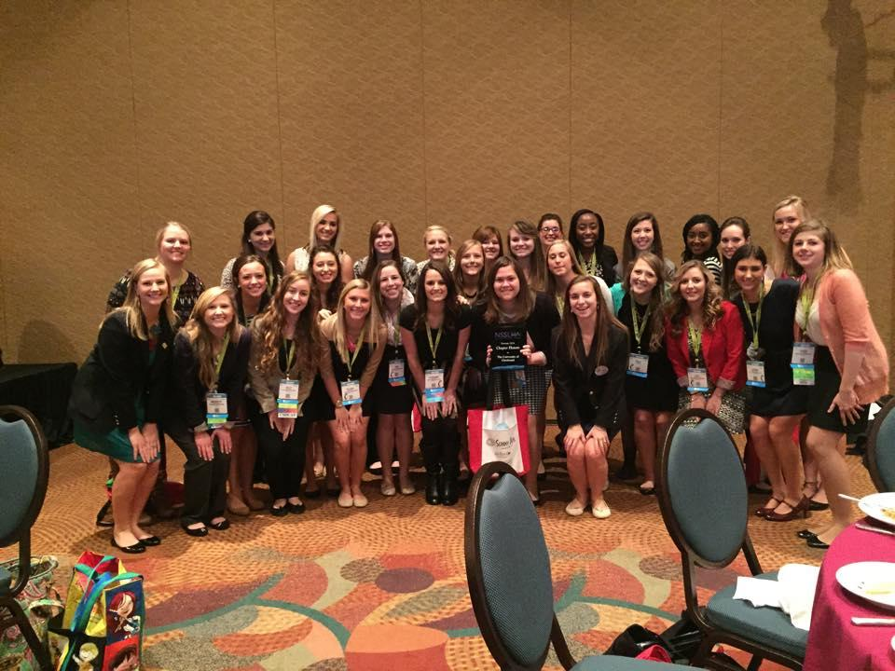
Congratulations for winning the NSSLHA Chapter of the
Year Award!!!!!!

