Slide 1
January NSSLHA Meeting

Slide 2
Welcome, 7HNH Guests!
Melinda Butsch-Kovacic & Wendy Yip
https://www.youtube.com/watch?v=oDYA4MDKcTU

Slide 3
Community Service
January
Craft, Lunch, & Learn: Wednesday, January 21st!
Contact Holly Finnegan at 513-803-2744 or holly.finnegan@cchmc.org to register!
Lunch will be provided with a presentation on craniofacial anomalies by Jennifer Marshall, MS CCC-SLP
Ronald McDonald House Snack: Tuesday, January 27th!
Arrive at 7pm
Please pre-register!!!
Bring food supplies for extra NSSLHA points!!

Slide 4
February
Little Sisters of the Poor Bingo: Wednesday, February 4th!
Arrive at 7pm!
Bring quarters for additional NSSLHA points!
Ronald McDonald House Snack: Wednesday, February 18th!
Arrive at 7pm!
Please pre-register!!!
Bring food supplies for extra NSSLHA points!!
Little Sisters of the Poor Bingo: Wednesday, February 25th!
Arrive at 7pm!
Bring quarters for additional NSSLHA points!

Slide 5
March
Ronald McDonald House Snack: Monday, March 2nd!
Arrive at 7pm!
Please pre-register!!!
Bring food supplies for extra NSSLHA points!!
Little Sisters of the Poor Bingo: Wednesday, March 25th!
Arrive at 7pm!
Bring quarters for additional NSSLHA points!

Slide 6
Fundraising
January-March: Basketball Games!
Sign-Up
Insomnia Cookies: Monday, February 2nd. 3 p.m.-3 a.m.
Pieology: TBA
Potbelly: TBA
Also a social event 1 point for showing up, 2 if you stay for the social!
*For these food fundraisers 1 NSSLHA point for attending and .5 point for every non-NSSLHA member you bring!

Slide 7
Relay For Life
Same day as banquet APRIL 10th
Join the team and raise $100 and you will still get 9 hours of community service and a t-shirt.
Key Chains- TBD will be either made at a meeting or done as a social event
Sign-Up
Click “Join Our Team” and follow the directions
Send link out to your PERSONAL page and have friends and family click “Donate Now”

Slide 8
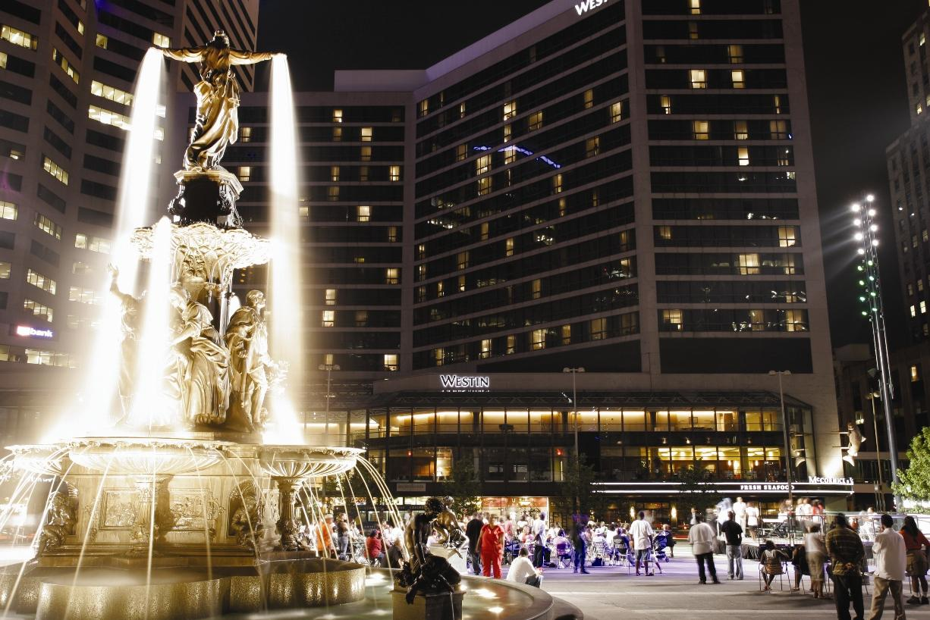
Socials
ICE SKATING!
When: Friday, January 30th from 4-6 pm on Fountain Square
Cost: $4 admission, $4 skate rental
We will be sending out a google doc
sign up, please fill it out by
January 25th!

Slide 9
Spring Newsletter
Please take one of the spring newsletter and check out the awesome articles about UC NSSLHA!

Slide 10
Spring Banquet
Date: Friday, April 10th from 7-11:00pm at The Madison in Covington, KY!
Invitations and RSVP’s to come in February!

Slide 11
Wine Bottle Donations
We will be taking donations of wine bottles for the annual wine bottle toss at the spring banquet!
Donations can be taken to Tammy Downey at the main CSD office on the 3rd floor of French East. Donations are worth a half NSSLHA point.

Slide 12
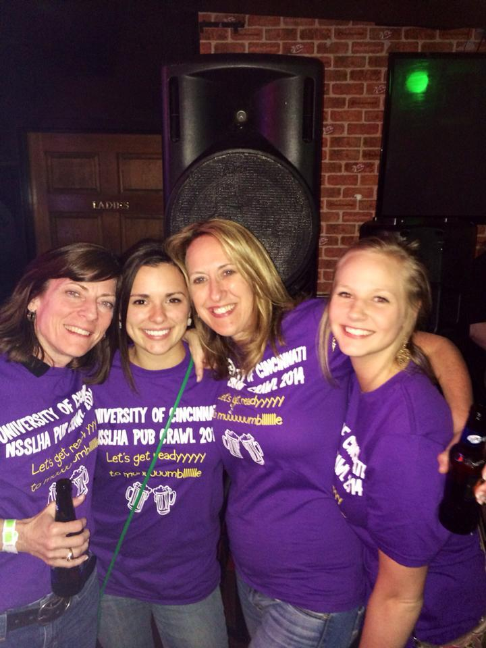
Senior Pub Crawl T-Shirts
-Color?
-Quote?
-Picture?
-Ideas?
I will be sending out a poll with
quotes/designs to vote on next week
PLEASE SEND ME YOUR IDEAS!
meyer2m2@mail.uc.edu

Slide 13
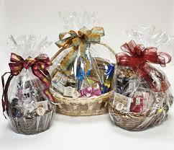
Silent Auction Baskets
Raffle winners choose from themed baskets
Donations are welcomed!
Family donations
Apparel/gift cards/items from work
Local business near you
Grab a donation letter!
All personal donations contact Meredith or Leah to arrange a pick up location

Slide 14
Top Ten!
Megan Davis
Kirsty Rae
Mary Parks
Seara Mayanja
Katie Schmittou
6. Grace Dumesnil
7. Sarah Crosby
8. Myriah Jackson
9. Corrine Deutenberg
10. Sarah Hemer
Keep up the good work!

