Slide 1
NSSLHA Meeting
April 3, 2014

Slide 2
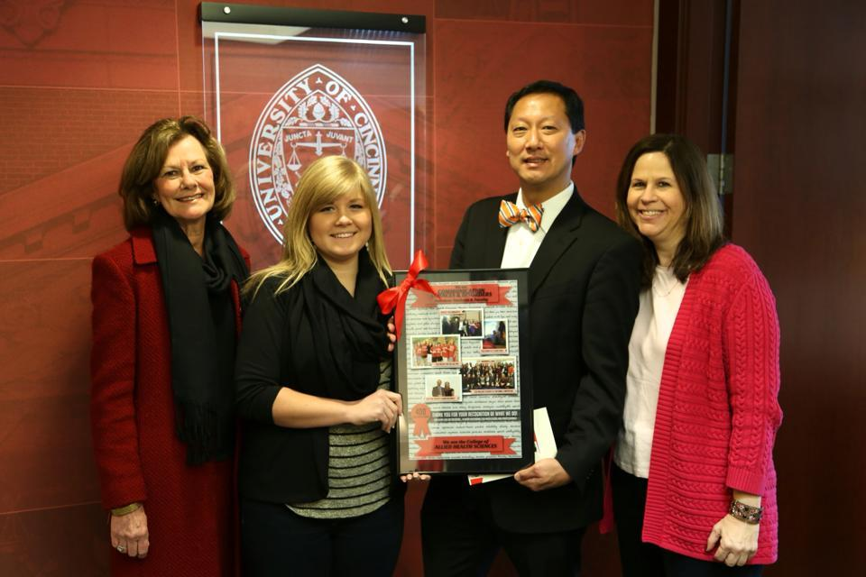
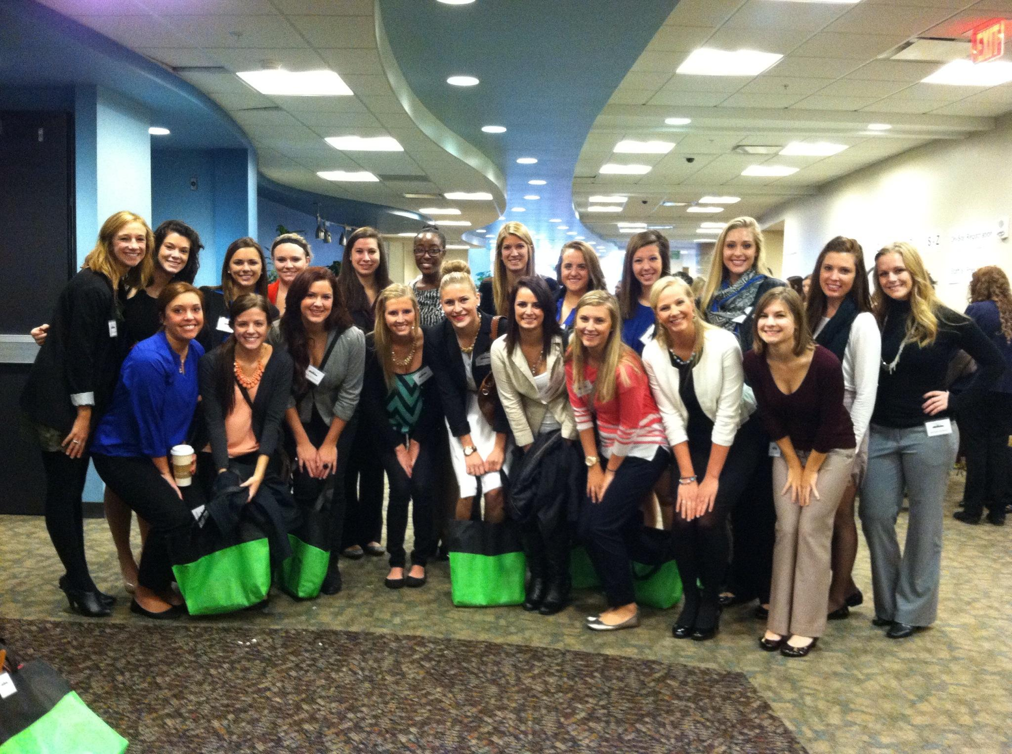
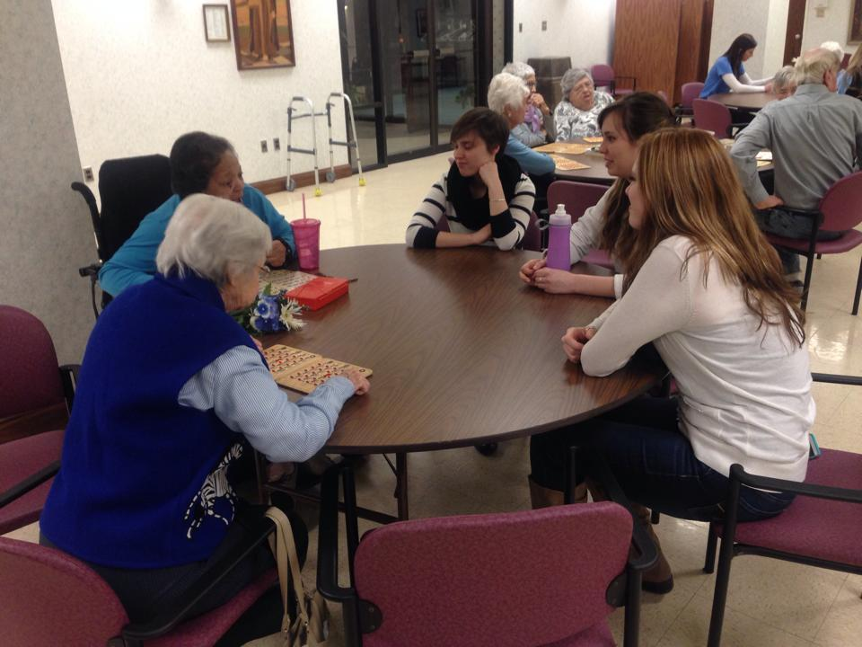
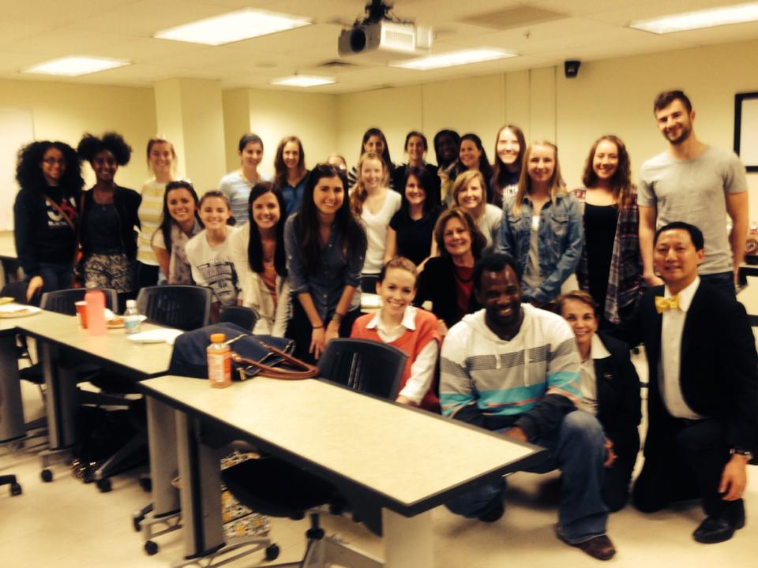
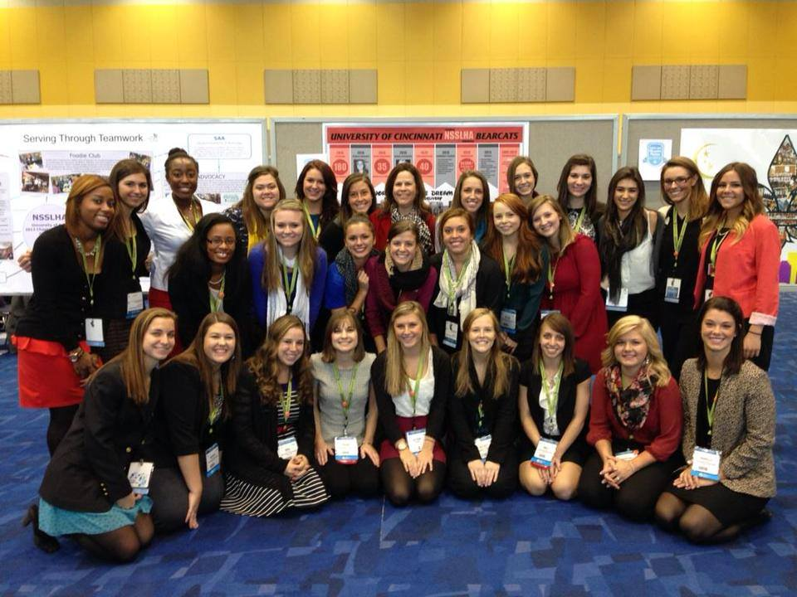
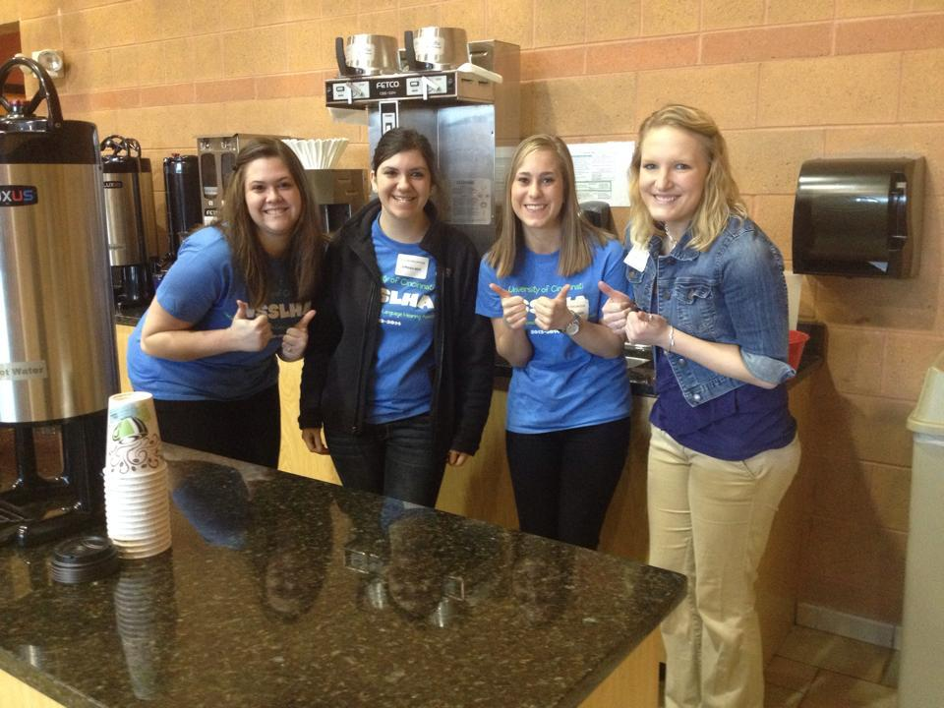
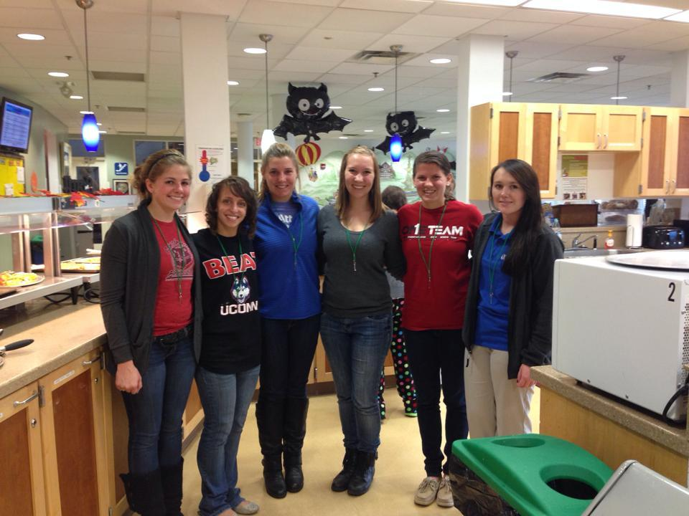
What a GREAT year!! :)

Slide 3
2013-14 Accomplishments :)
40+ UC Students attended ASHA in Chicago!
25+ NSSLHA members attended the Ohio NSSLHA Conference at Cleveland State University
UC NSSLHA was awarded $1750 at the 2013 ASHA Convention for winning the Charge Up Your Chapter Poster Contest, winning the Chapter with the most donations to the ASHFoundation, placing 2nd for the chapter with the most students registered for the ASHA Convention by October 31st
Community Service-Ellie
Fundraising-made +4000!!
We are so proud of our chapter!!

Slide 4
Top 10 NSSLHA Members!
1. Rilie Mangan
2. Maria Hardin
3. Sarah Colligan
4. Sarah Tuohy
5. Megan Davis
6. Kelly Gatch
7. Stephanie Bare
8. Alyssa morrow
9. Rachel DeLord
10. Danielle Shanks

Slide 5
Bringing in Donations!
Here is the Google doc:
https://docs.google.com/spreadsheet/ccc?key=0Ai58iA7JUswydDdfUFE0cVNabDIzR2hZdGhZSEh0Vmc&usp=sharing#gid=0
If there is anything left you would like to bring in, let me know!

Slide 6
Points!
You need to email me for points if:
You went to OSLHA
You went to KSHA
Top 10 will be recognized at banquet!

Slide 7
Banquet Update
Friday, April 18th 7:30-11pm at The Madison in Covington, KY!
FINAL RSVP due date: Monday, April 7th

Slide 8
Wine Toss
There is still time to donate!
2 points per bottle!! (8 pt. max)
Ask Family!
Ask Friends!
Ask Employers!
donate, Donate, DONATE! :)
Contact me with questions at palmerjc@mail.uc.edu
Bring donations to me or Rm. 344 in French East with your name attached

Slide 9
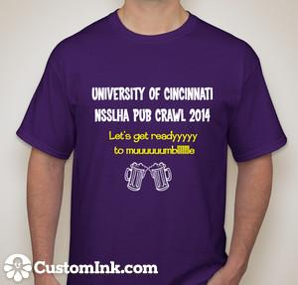
Pub Crawl Update
T-Shirts are here!!
Handing them out in class tomorrow
If you have not paid, please turn in your money tomorrow!
April 11th (next Friday!)
Sending out Google Doc. tonight to get # of people who want to eat dinner beforehand (Keystone/Bdubs)
Specific timing and route will be sent out in an email soon

Slide 10
Community Service Update
THANK YOU to everyone that has helped make all of the community service events such a success! You are very appreciated!
We will be teaming up with Miami U for the Ronald McDonald House April 7th!

Slide 11
RELAY FOR LIFE
CHECK YOUR EMAIL! There is extremely important information that Sarah and I have been sending out.
We should know very soon if Relay will be relocated to TUC (it’s supposed to storm:( ).
We have raised $1,855 dollars!! (92% of our goal)
I’m bringing the t-shirts to the event!
Fundraiser: bake sale and photobooth!
If you donate baked goods please cut and bag them prior to the event!

Slide 12
Miami 5K!
Miami U will be hosting a 5K run, walk, or jog on April 12th!
Proceeds will be going to raise money for their clinic!
For more information go to colorforkids2014.wix.com/color-for-kids or email Kristen Siskovich at siskovkm@miamioh.edu

Slide 13
Spring Newsletter
Published soon after the CSD Banquet
Feel free to contribute(photos from OSLHA/service events, articles from experiences, fun facts, etc)
email me! baccuslm@mail.uc.edu

Slide 14
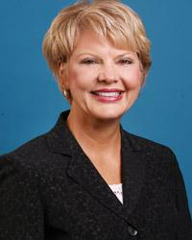
Dr. Ann Kummer PhD, CCC-SLP, ASHA-F
Senior Director, Division of Speech-Language Pathology
University of Cincinnati Medical Center Professor of Clinical Pediatrics; Professor of Otolaryngology, Head and Neck Surgery; Adjunct Professor of Communication Sciences and Disorders
Email: ann.kummer@cchmc.org

