Slide 1
NSSLHA Meeting
January 16th, 2014

Slide 2
Welcome Back!
Meet someone new!
Share your New Year’s Resolution
Favorite Holiday gift

Slide 3
Inspirational Clip-Tim’s Place
http://www.amazingoasis.org/2013/12/restaurant-owner-with-down-syndrome.html?m=1

Slide 4
NSSLHA Top 10
1. Rilie Mangan
2. Maria Hardin
3. Sarah Colligan
4.Stephanie Bare
5. Danielle Shanks
6. Alyssa Morrow
7. Morgan Davis
8. Danielle Fultz
9. Jessica Moyer
10. Racheal Schafer

Slide 5
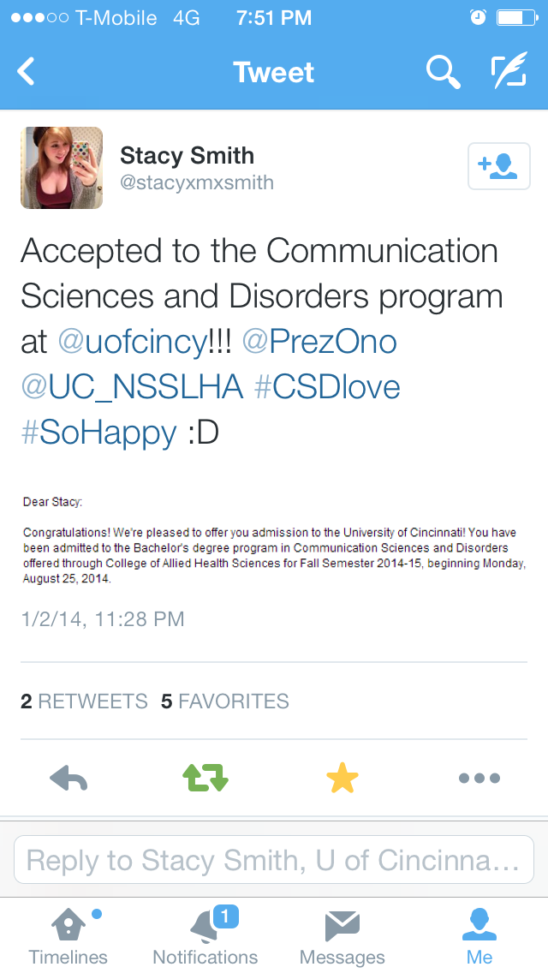
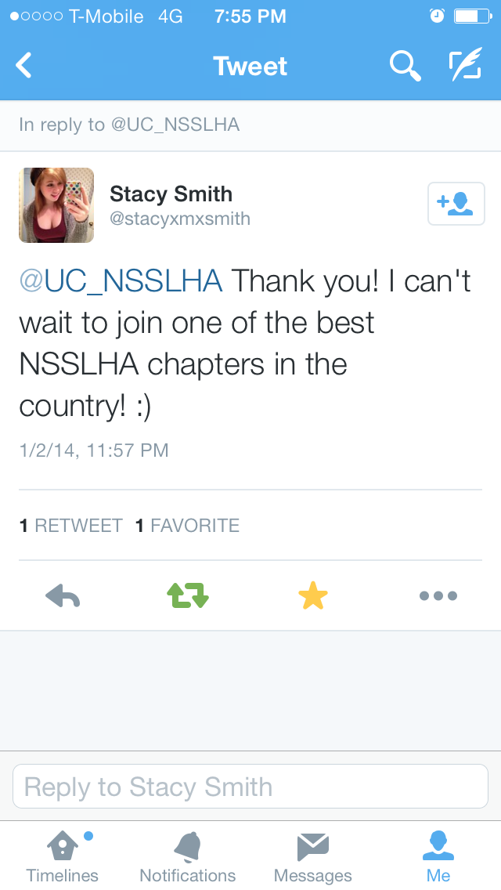
#CSDlove on Twitter!

Slide 6
Side Note on Points..
Please email me your points from mentoring and Orange Leaf because that is the only way I will know!
murrismm@mail.uc.edu

Slide 7
Mentoring
If you are new to CSD and interested in having a junior/senior mentor, email me so I can set you up with one!

Slide 8
CSD Banquet
Friday, April 18th
Raffle Baskets
Donation Letter
Want to head your own basket?
Wine Donations

Slide 9
Fundraising Update
We are donating $152.89 to Fluency Friday!
Time to start working basketball games!
On Saturday the 11th Andre and Sarah Tuohy sold about 8 kegs worth of beer!!!

Slide 10
Community Service Lottery
Little Sisters of the Poor
We hold bingo nights from 7-8:30pm for the residents of the nursing home
January 29th
February 26th
March 26th

Slide 11
Community Service Lottery
Ronald McDonald House
Preparing either a dinner or snack for the families of the Ronald McDonald House
February 20th from 7-8:30pm
March 4th 5:30-7pm

Slide 12
Community Service Lottery
Fluency Friday
A day of discounted or free speech therapy provided to students in the CPS system by the staff of UC and Children’s held from 8:00am to 4:00pm at The Vineyard. The volunteers will help with registration and watching the students between therapy sessions and lunch.
February 23rd

Slide 13
Community Service Lottery
Stuffing folders for the Fluency Friday
The Fluency Friday staff needs our help getting all of the students paperwork organized and put into folders. This will be held in French East.
Tuesday, February 18th 9:00am-12:00pm

Slide 14
Craft, Lunch, & Learn
Craft, Lunch, & Learn
This is hosted by the SLP Department of Children’s, help make crafts for SLP’s to use during therapy sessions. Free lunch is also provided and there is typically a keynote speaker, too!
January 30th 9:00am-1:00pm and 12:00pm-4:00pm

Slide 15
Relay For Life
April 4th and 5th
ANYONE can do this event! To sign up for the NSSLHA Relay team you can go to https://secure.acsevents.org/site/TRR/RelayForLife/RFLCY14EC/2091558567?pg=utype&fr_id=56563 . This link as well as the directions can be found on our FaceBook page and the NSSLHA BlackBoard site!
Our goal→ $1,000!

Slide 16
Upcoming Events/ Meetings
February: Dr. Erin Redle: Children's Hospital
March: Meeting with University of Miami’s Chapter-Dr. Kummer speaking
April- NSSLHA Party, Reds Game, Juniors: Advice from Seniors, Senior Pub Crawl, CSD Banquet

Slide 17
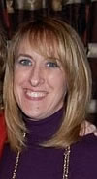
Dr. Sandra Combs
Ohio Speech-Language
Hearing Association
(OSLHA) President

