Slide 1
NSSLHA Meeting
Third Meeting | November 5th

Slide 2
Vote for your favorite dish!!
yumm :)

Slide 3
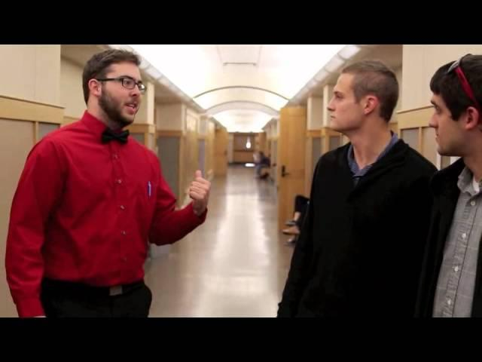
Motivational Clip?

Slide 4
GRE Word of the Day
Laconic: using few words
Sentence: I hope UC students are not laconic in their graduate school interviews.

Slide 5
Ohio NSSLHA Conference
Thank you for all those that attended! It was great success and we represented UC very well!

Slide 6
ASHA
37 total undergraduates signed up!!
Mandatory meeting following the chapter meeting.
If you cannot stay, please coordinate a time to meet with me or Morgan

Slide 7
T-shirts and Tote bags
T-shirts are in! Pick them up tonight :)
Tote bags - Have not heard anything back from Semester’s yet, but I did place the order and will get them to you ASAP!

Slide 8
Top 10 NSSLHA Members
1. Rilie Mangan
2. Sarah Colligan
3. Maria Hardin
4. Stephanie Bare
5. Sarah Tuohy
6. Danielle Shanks
7. Sarah Crosby
8. Tiffany Moody
9. Amberly Fancher
10. Chelsea Bartley

Slide 9
Mentoring Program
Make sure you email me when you meet and for how long for points!
murrismm@mail.uc.edu
December Contest: Best Christmas Cookies
Mentoring pairs can enter together!

Slide 10
OSLHA
Ohio State Speech-Language-Hearing Association
Only $20 student membership!
(4 NSSLHA Points for joining)
Convention: March 13-15, 2014 (Thursday-Saturday)
Columbus, Ohio
Volunteer Opportunity!
Sheet going around to sign up

Slide 11
Fundraising Update
Next football concessions Dec. 5th!!! Sign up on the Google doc Now!
Brunch For Lunch- Thursday Nov. 21st 11am-1pm WE NEED VOLUNTEERS Sign-up to bring things Fluency Friday Fundraiser- at Orange Leaf Friday Nov. 22nd All-day!

Slide 12
Community Service Update
Ronald McDonald House
November 14th 7:00pm
SIGN UP BEFORE!
Craft Lunch and Learn @ Children’s
Friday, November 22nd
9am-1pm and 12pm-4pm

Slide 13
Leah- Fall Newsletter
E-mail me if you would like to help with the Fall Newsletter!

Slide 14
December Social
Ice Skating!!
-At Fountain Square Downtown
-$3 skate/ $3 Rental

Slide 15
Upcoming Events
ASHA
December Meeting-Weds Dec. 4th (CATS game on Thursday night)
Possible event in the Spring with the Miami NSSLHA Chapter!

Slide 16
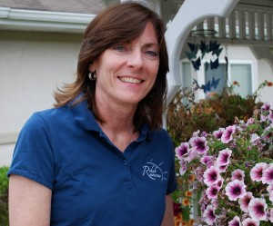
Terri Hollenkamp MA, CCC-SLP
UC Professor
President & CEO of Rehab Resources & Rehab on the Run

